Slide 1
WEB SECURITY VULNERABILITIES

Slide 2
INJECTION ATTACK
Injection attacks are web application attacks that allow an attacker to supply untrusted input to a program, which gets processed by an interpreter as part of a command or query which alters the course of execution of that program.
They can result in data theft, data loss, loss of data integrity, denial of service, as well as full system compromise.
SQL injection (SQLi) and Cross-site Scripting (XSS) are the most common injection attacks but they are not the only ones.

Slide 3
SQL INJECTION (SQLI)
SQL Injection (SQLi) is a type of an injection attack that makes it possible to execute malicious SQL statements.
By exploiting an SQL injection vulnerability, an attacker can add, delete, edit or read content in the database.

Slide 4
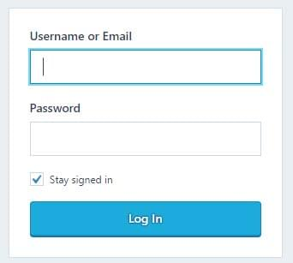
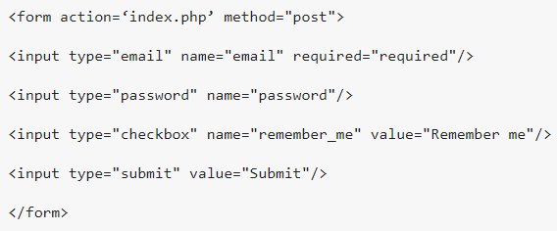
How SQL Injection Attacks Work
Query to be executed when the form is submitted:
SELECT * FROM users WHERE email = $_POST['email'] AND password = md5($_POST['password']);
Suppose user supplies admin@admin.sys and 1234 as the password. The statement to be executed against the database would be
SELECT * FROM users WHERE email = 'admin@admin.sys' AND password = md5('1234');

Slide 5
The above code can be exploited by commenting out the password part and appending a condition that will always be true.
admin@admin.sys' OR 1 = 1 --
000
The generated dynamic statement will be as follows:
SELECT * FROM users WHERE email = ‘admin@admin.sys’ OR 1 = 1 -- AND password = md5(‘000’);
More Examples for malicious inputs:
admin@admin.sys’ ; DROP TABLE users --
admin@admin.sys’ UNION SELECT * FROM users --

Slide 6

PREVENTION
Parameterized Statements
Parameterized queries force the developer to first define all the SQL code, and then pass in each parameter to the query later. This coding style allows the database to distinguish between code and data, regardless of what user input is supplied.
Escaping Inputs
Escaping symbol characters is a simple way to protect against most SQL injection attacks and many languages have standard functions to achieve this. (mysqli_real_escape_string in PHP)
Sanitizing Inputs
Developers should always make an effort to reject inputs that look suspicious.
Examples:
Check that supplied fields like email addresses match a regular expression.
Ensure that numeric or alphanumeric fields do not contain symbol characters.
Reject (or strip) out whitespace and new line characters where they are not appropriate.

Slide 7
CROSS-SITE SCRIPTING
Cross-site scripting (XSS) is a code injection attack that allows an attacker to execute malicious JavaScript in another user's browser.
Persistent XSS – the malicious string originates from the website's database.
Example : Comment section
Reflected XSS - the malicious string originates from the victim's request.
Example : Search section

Slide 8
Consequences
Cookie theft
The attacker can access the victim's cookies associated with the website using document.cookie, send them to his own server, and use them to extract sensitive information like session IDs.
Keylogging
The attacker can register a keyboard event listener using addEventListener and then send all of the user's keystrokes to his own server, potentially recording sensitive information such as passwords and credit card numbers.
Phishing
The attacker can insert a fake login form into the page using DOM manipulation, set the form's action attribute to target his own server, and then trick the user into submitting sensitive information.

Slide 9
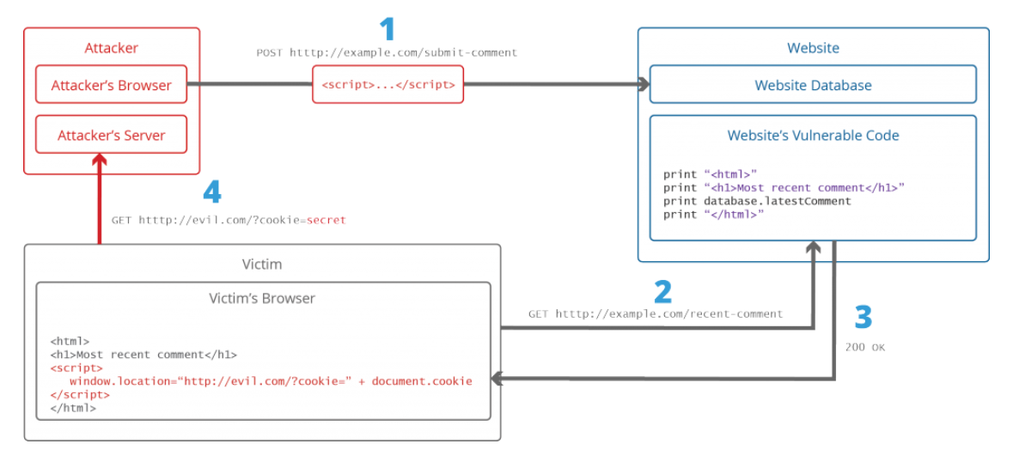
Persistent XSS Example

Slide 10
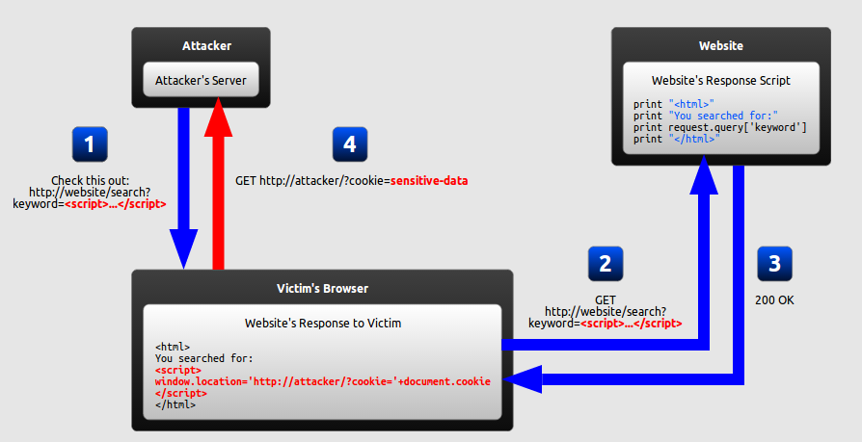
Reflected XSS Example

Slide 11
PREVENTION
Encoding
Encoding is the act of escaping user input so that the browser interprets it only as data, not as code. The most recognizable type of encoding in web development is HTML escaping, which converts characters like < and > into &lt; and &gt;, respectively.
Validation
Validation is the act of filtering user input so that all malicious parts of it are removed, without necessarily removing all code in it. One of the most recognizable types of validation in web development is allowing some HTML elements (such as <em> and <strong>) but disallowing others (such as <script>).

Slide 12
CROSS-SITE REQUEST FORGERY (CSRF)
Cross-site request forgery (CSRF) is another common web vulnerability, in which an attacker tricks the victim's browser into generating requests to a website which performs certain actions on behalf of the logged in user or the victim.

Slide 13
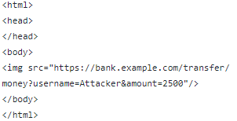
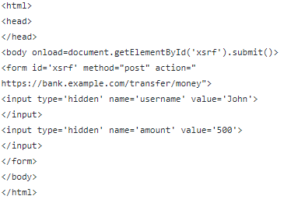
EXAMPLE
GET request
https://bank.example.com/transfer/money?username=John&amount=500
Attacker’s phishing page source code =>
POST request
https://bank.example.com/transfer/money
Attacker’s phishing page source code =>

Slide 14
PREVENTION
CSRF Tokens
The most popular method to prevent Cross-site Request Forgery is to use a challenge token that is associated with a particular user and that is sent as a hidden value in every state-changing form in the web app.
Workflow:
The web server generates a token and stores it
The token is statically set as a hidden field of the form
The form is submitted by the user
The token is included in the POST request data or in headers
The application compares the token generated and stored by the application with the token sent in the request
If these tokens match, the request is valid
If these tokens do not match, the request is invalid and is rejected
It protects the form against Cross-site Request Forgery attacks because an attacker would also need to guess the token to successfully trick a victim into sending a valid request. The token should also be invalidated after some time and after the user logs out.
For an anti-CSRF mechanism to be effective, it needs to be cryptographically secure.

Slide 15
PREVENTION
Same-Site Cookies
Two URLs have the same origin if the protocol, port(if specified), and host are the same for both.
CSRF attacks are only possible because cookies are always sent with any requests that are sent to a particular origin related to that cookie
You can set a flag for a cookie that turns it into a same-site cookie. A same-site cookie is a cookie that can only be sent if the request is being made from the origin related to the cookie (not cross-domain).
A current limitation of same-site cookies is that unlike for example Chrome or Firefox, not all current browsers support them, and older browsers do not work with web apps that use same-site cookies

Slide 16
INSECURE CRYPTOGRAPHIC STORAGE
Insecure Cryptographic storage is a common vulnerability which exists when the sensitive data is not stored securely.
This data will be stored on the application database. When this data are stored improperly by not using encryption or hashing , it will be vulnerable to the attackers.

Slide 17
ENCRYPTION
Encryption is the practice of scrambling information in a way that only someone with a corresponding key can unscramble and read it. Encryption is a two-way function. When you encrypt something, you’re doing so with the intention of decrypting it later.
To encrypt data you use something called a cipher, which is an algorithm – a series of well-defined steps that can be followed procedurally – to encrypt and decrypt information.
Types :
Symmetric (AES)
Symmetric encryption incorporates only one key for encryption as well as decryption.
Asymmetric(RSA)
Asymmetric Encryption consists of two cryptographic keys. These keys are regarded as Public Key and Private Key

Slide 18
HASHING
Hashing is the practice of using an algorithm to map data of any size to a fixed length.
Whereas encryption is a two-way function, hashing is a one-way function. While it’s technically possible to reverse-hash something, the computing power required makes it unfeasible. Hashing is one-way.
Every hash value is unique. If two different files produce the same unique hash value this is called a collision and it makes the algorithm essentially useless.
Google created a collision with the SHA-1 hashing algorithm to demonstrate that it’s vulnerable. SHA-1 was officially phased out in favor of SHA-2 in early 2016
Salting is a concept that typically pertains to password hashing. Essentially, it’s a unique value that can be added to the end of the password to create a different hash value. This adds a layer of security to the hashing process, specifically against brute force attacks.
By salting your password you’re essentially hiding its real hash value by adding an additional bit of data and altering it.

Slide 19
STORING PASSWORDS
Plain-text passwords
If you store plain text passwords , someone steals the data through any sort of security hole, they’ve got all your user’s plain text passwords.
Straight hashing
Vulnerable by offline dictionary attacks using rainbow tables.
A rainbow table is a precomputed table for reversing cryptographic hash functions, usually for cracking password hashes.
Salting of hashes can add another layer of security to this method.
A single salt should never be used for all the passwords.
The salt values should never be stored along with the password hashes.(Preferably should be stored on server)
Slow hashes
Generic hash functions like MD5 and SHA-1 are built to be fast. And because computers keep getting faster, millions of hashes can be calculated very very quickly, making a brute-force attack even of salted passwords more and more feasible.
Therefore slow hashing functions like bcrypt, PBKDF2 or scrypt should be used.

Slide 20
INSUFFICIENT TRANSPORT LAYER PROTECTION
Deals with information exchange between the user (client) and the server (application). Applications frequently transmit sensitive information like authentication details, credit card information, and session tokens over a network.
By using weak algorithms or using expired or invalid certificates or not using SSL can allow the communication to be exposed to untrusted users, which may compromise a web application and or steal sensitive information.

Slide 21
HTTP? HTTPS? SSL? TLS?
HTTP is the protocol used by your browser and web servers to communicate and exchange information.
When that exchange of data is encrypted with SSL/TLS, then we call it HTTPS. The "S" stands for "Secure".
SSL stands for Secure Sockets Layer and, in short, it's the standard technology for keeping an internet connection secure and safeguarding any sensitive data that is being sent between two systems, preventing criminals from reading and modifying any information transferred, including potential personal details.
TLS (Transport Layer Security) is just an updated, more secure, version of SSL. We still refer to our security certificates as SSL because it is a more commonly used term.
The main purpose of SSL/TLS is to provide confidentiality, authenticity and integrity to the user.

Slide 22
PREVENTION
Use TLS For All Pages
TLS should be used for all pages, not just those that are considered sensitive such as the login page. If there are any pages that do not enforce the use of TLS, these could give an attacker an opportunity to sniff sensitive information such as session tokens, or to inject malicious JavaScript into the responses to carry out other attacks against the user.
Do Not Mix TLS and Non-TLS Content
A page that is available over TLS should not include any resources (such as JavaScript or CSS) files which are loaded over unencrypted HTTP. Modern browsers will also block attempts to load active content over unencrypted HTTP into secure pages.
Use the “Secure” Cookie Flag
All cookies should be marked with the “Secure” attribute, which instructs the browser to only send them over encrypted HTTPS connections, in order to prevent them from being sniffed from an unencrypted HTTP connection.
Prevent Caching of Sensitive Data
Use HTTP Strict Transport Security(HSTS)

Slide 23
PREVENTION
Prevent Caching of Sensitive Data
Use HTTP Strict Transport Security
HTTP Strict Transport Security (HSTS) instructs the user’s browser to always request the site over HTTPS, and also prevents the user from bypassing certificate warnings.
TLS should be used for all pages, not just those that are considered sensitive such as the login page. If there are any pages that do not enforce the use of TLS, these could give an attacker an opportunity to sniff sensitive information such as session tokens, or to inject malicious JavaScript into the responses to carry out other attacks against the user.
Do Not Mix TLS and Non-TLS Content
A page that is available over TLS should not include any resources (such as JavaScript or CSS) files which are loaded over unencrypted HTTP. Modern browsers will also block attempts to load active content over unencrypted HTTP into secure pages.
Use the “Secure” Cookie Flag
All cookies should be marked with the “Secure” attribute, which instructs the browser to only send them over encrypted HTTPS connections, in order to prevent them from being sniffed from an unencrypted HTTP connection.

Slide 24
THANKS

